Slide 1
Fluid Project
Proper Orthogonal Decomposition on Schlieren Images
Somil Maheshwari
Nikhil Gangwar
Abhishek Kumar
Aman Bhansali
Rushil Samir Patel

Slide 2
Introduction

Slide 3
Introduction to schlieren imaging
Schlieren imaging is a process for photographing fluid flow.
The schlieren imaging technique is a classical optical flow visualization technique based on density changes in the fluid.
Schlieren optics measure the change in the refractive index of either air or another transparent media, and this enables flow patterns around an object to be imaged
It is a technique that is used to not only determine the characteristics of the airflow itself but to also evaluate how an object behaves in certain airflow environments.
Notes:
jets fly at incredible speeds that exceed the speed of sound, called supersonic speeds. When describing supersonic speeds, we use Mach number to gauge that speed relative to the speed of sound. At a Mach number greater than 0.8, but less than 1.2, the speed is transonic. Above Mach 1.2, the speed is supersonic.
Principles
Compressible flow, or high-speed flow, occurs when fluids experience significant changes in their density. When supersonic flow passes by a body, shock waves and expansion waves are formed around the body. A shock wave is an extremely thin propagating disturbance, where sudden changes in flow properties, like pressure, temperature, and density, occur. The density of air changes significantly within the shock wave and expansion fans, they can be visualized using a density-based flow visualization technique, called Schlieren Imaging.
The Schlieren method relies on refractive index, which is the ratio of light's velocity in a vacuum, to its velocity within a specific medium. The change in refractive index is proportional to the change in density. Thus, as the density of air changes in the shock wave, the refractive index also get change

Slide 4
Background
Schlieren imaging systems have been used since the early 1800’s to visualize fluctuations in optical density, but between 1859 and 1864, August Toepler rediscovered the technique and named it after the German term for optical inhomogeneities in glass . The term "Schlieren" refers to any optical inhomogeneities in a transparent medium.

Slide 5
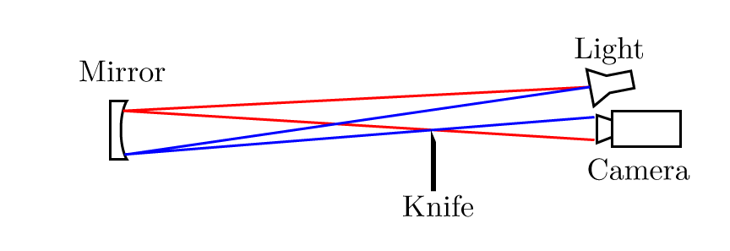
SETUP
The schlieren technique relies on small differences in the index of refraction bending light rays behind an obstruction.
Reference:- jove.com
Notes:
In Schlieren Imaging, a collimated light source shines on the body, and the variation in refractive index distorts the light beam.The camera is located further back on the axis of the mirror. In order to visualize the deflection, a knife-edge is placed at the focal plane of the transmitted light, thus, blocking some of the deflected light, and enhancing the contrast of the projected image on screen. This results in an image of high and low light intensity, which maps the areas of high and low air density, thus enabling us to visualize the shock waves and expansion fans.
A concave mirror with a long focal distance. The longer the focal length the better image you will get. A long focal-length mirror is used to focus a point source of light onto a knief. source directs light onto a long radius concave spherical mirror, which collimates the light and redirects it onto a second identical mirror. The resultant image is captured by an camera.
A camera.
A point light source.
A knifes edge or color filter.
When a knife edge is used, the system is generally referred to as a schlieren system, which measures the first derivative of density in the direction of the knife edge. If a knife edge is not used, the system is generally referred to as a shadowgraph system, which measures the second derivative of density.
Without a knife edge to block the light resulting images were too bright, making it impossible to see the flow of air movement. By moving the knife edge to block part of the light the images became visible. The amount of light blocked by the knife edge is commonly referred to as “cutoff”
A knife edge is placed at the focal point of the spherical mirror and is positioned to block off half the light at the focal point.
Undeflected light rays are affected uniformly by the knife edge and the intensity of the image is reduced with increased cutoff. As light passes through a density field with a non-constant first derivative, the light rays are deflected

Slide 6
PROCEDURE
Activate the dryer towers to dehydrate the air
Check if the test section is clear of other objects, then close test section.
Make sure the main valve for air flow control is closed, then turn on the compressor to pressurize the air storage tank.
Turn on the controller for the high-speed valve
Turn on the light and cooling fan of the schlieren imaging system.
Place a piece of paper on the opposite side of the test section from the light source
Align the concave mirror to allow light to pass through the test section.
Adjust the knife-edge so that it is at the focal point of mirror.
Position a camera on a tripod directly in front of the knife-edge aperture to record the projected image.
Open the air supply to the fast-valve controller, then open the main valve that lets air into the system.
Turn off the wind tunnel by closing the valves in reverse order. Then turn off the controller.
Notes:
1.This will ensure that the air flow does not contain moisture, and will prevent ice formation when the local temperature in the test section drops due to the supersonic flow.
4.and set the parameter
7.Check that the light hits the paper.
8.And adjust the aperture of the knife-edge to achieve the desired image quality.
11.Activate the wind tunnel.
PARAMETERS :- PL,DF,LC,RH,RL,MODE,MH

Slide 7
OTHER TECHNIQUES
Before schlieren imaging the Shadowgraph techniques are used to visualise the compressible flow.In shadowgraph the second derivative of density is not constant while the,first and third derivative are constant.
Shadowgraphs are typically used to study shocks as these flow features create non-constant second derivatives in density. Shadowgraphs are also useful for imaging boundary layers and turbulent flows. Shadowgraphs have an advantage over schlieren setups for such flows because shadowgraph visualization is uniformly sensitive in all directions.
The primary difference is that while shadowgraphs are sensitive to changes in the second derivative in density, schlieren systems detect changes to the first derivative in density.
Reference: https://shepherd.caltech.edu
Notes:
This is the simplest methods for visualizing compressible flows

Slide 8
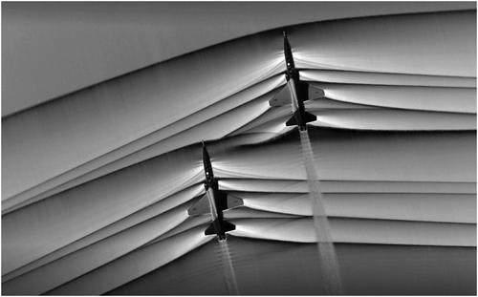
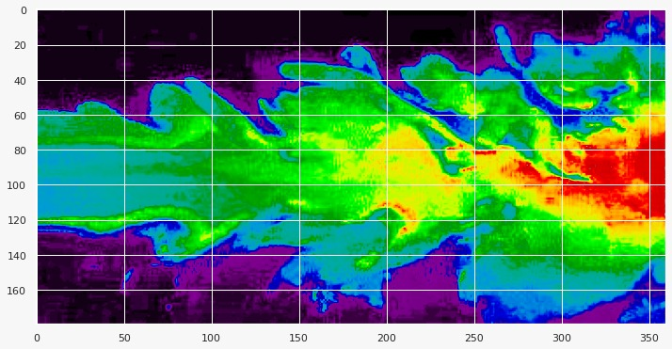
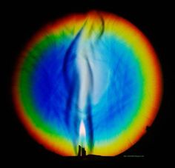
Application of Schlieren Imaging
Schlieren optics can be used to determine how aerodynamic an aircraft is by imaging how the air moves around it.
Schlieren imaging provides valuable information on the spatial distribution of complicated flow structures in compressible, turbulent flow and in test flights.
It used in air-to-air photography of supersonic aircraft, which involves using the sun and/or moon as a light source and the desert floor as the projecting surface to visualize the shock waves.
supercomputers and wind tunnel testing are used to predict the formation, propagation, and merging of shock waves on an aircraft. To enhance the quality of these predictions, a database of sonic boom measurements are collected at various speeds and altitudes. This technique permits supersonic flow visualization of a full-scale aircraft, rather than a scaled-down model.
Scramjets are air breathing engines that rely on the pure speed of an aircraft to compress air into the engine before combustion.
Notes:
2.spatial means connected with the size or position and area of something
4.This technique permits supersonic flow visualization of a full-scale aircraft, rather than a scaled-down model.
5.Focusing-schlieren visualization is able to show fuel jets, turbulent structures of mixing, and shock waves inside the scramjet engine.

Slide 9
Limitations
Size and portability.
All subjects must be stationary, or small enough to move within the field of view of the system, as the system itself is not significantly flexible or portable.
Another considerable limitation is the cost of constructing a basic schlieren system.
Notes:
the size of the system itself is dependent on the size and focal-length of the mirror, meaning a smaller mirror would be more compact; in a compact system we have to sacrifices image size, as the image captured is dependent on the size of the mirror reflecting it
schlieren systems require high-quality, polished field mirrors and lenses, as any defects in optical components can result in aberrations and distortions in the schlieren images

Slide 10
POD on Dot Schlieren

Slide 11
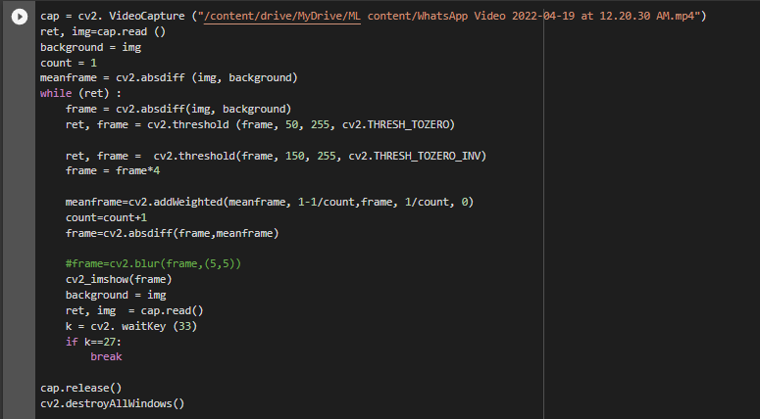
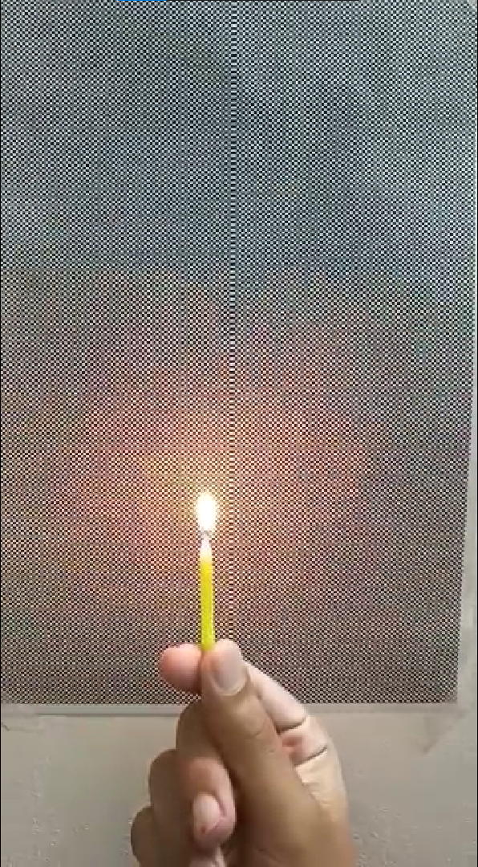
Implementation of Dot Schlieren Method
Reference:
https://youtu.be/J0Ix4Wa3CJk

Slide 12
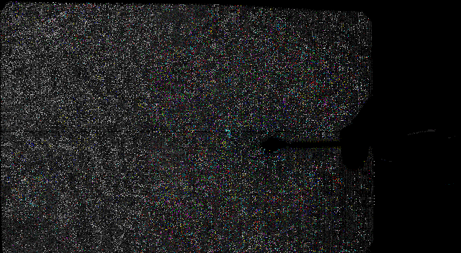
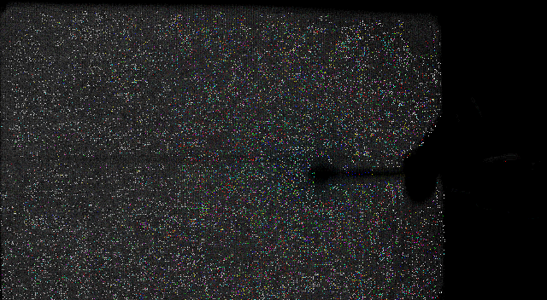
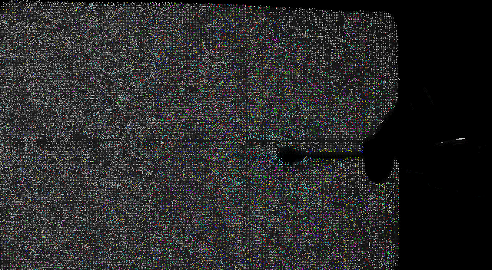

Slide 13
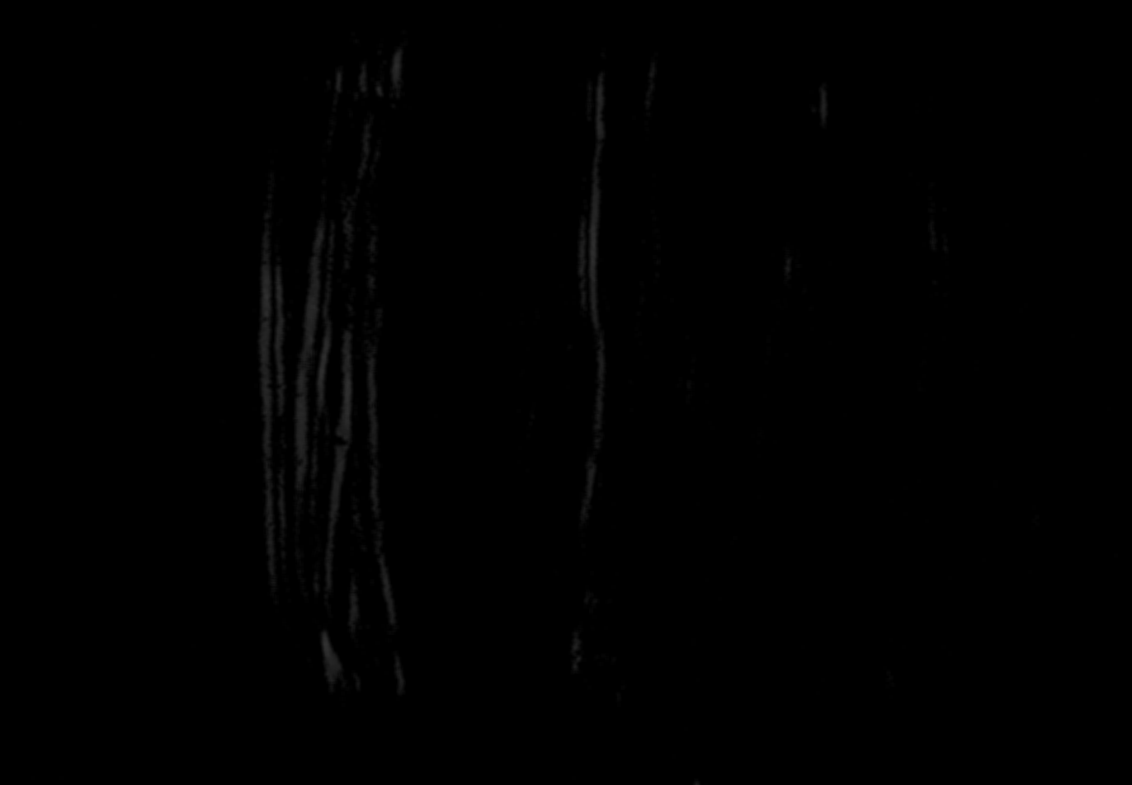
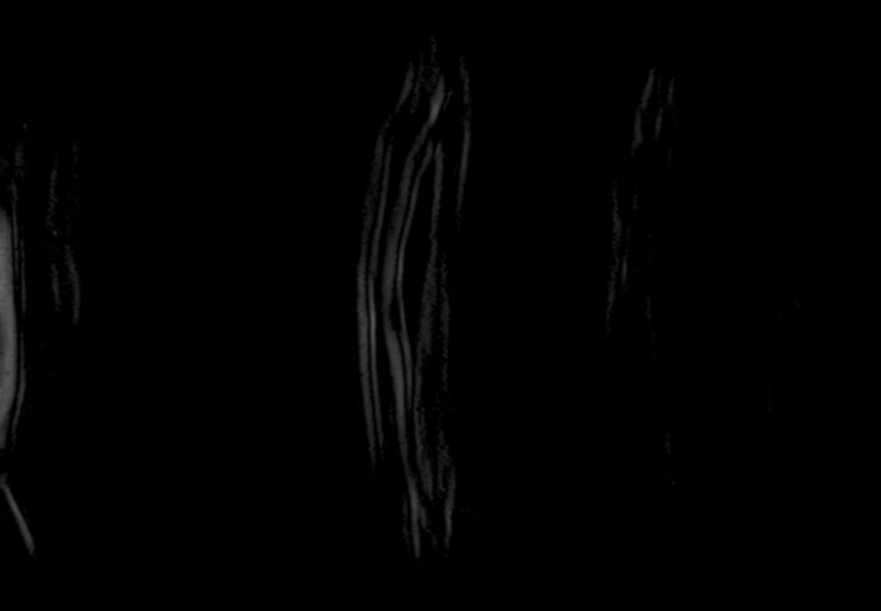
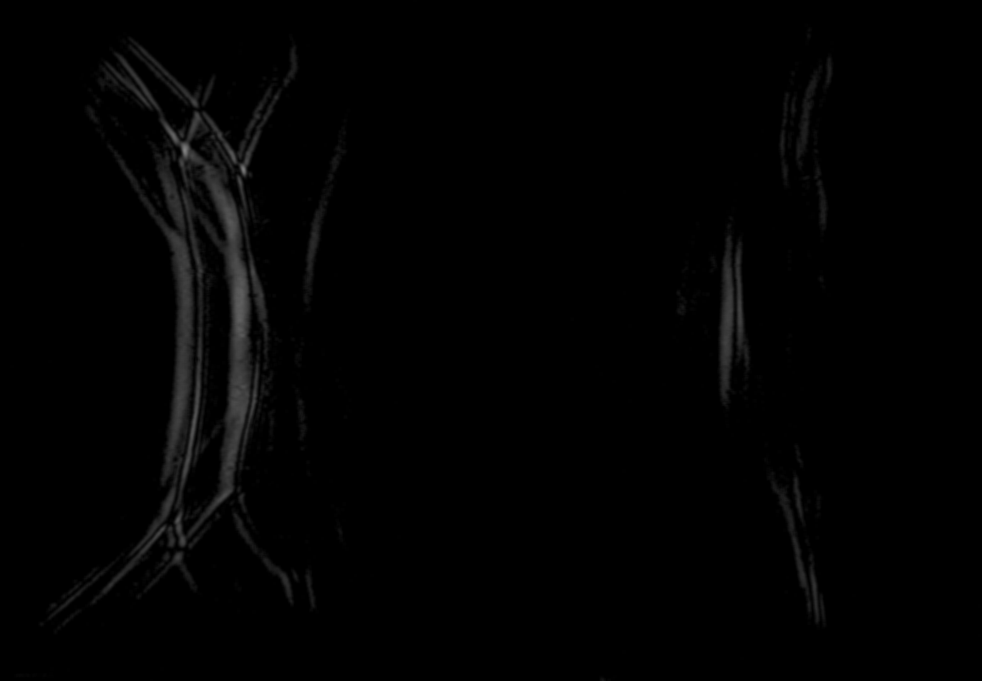
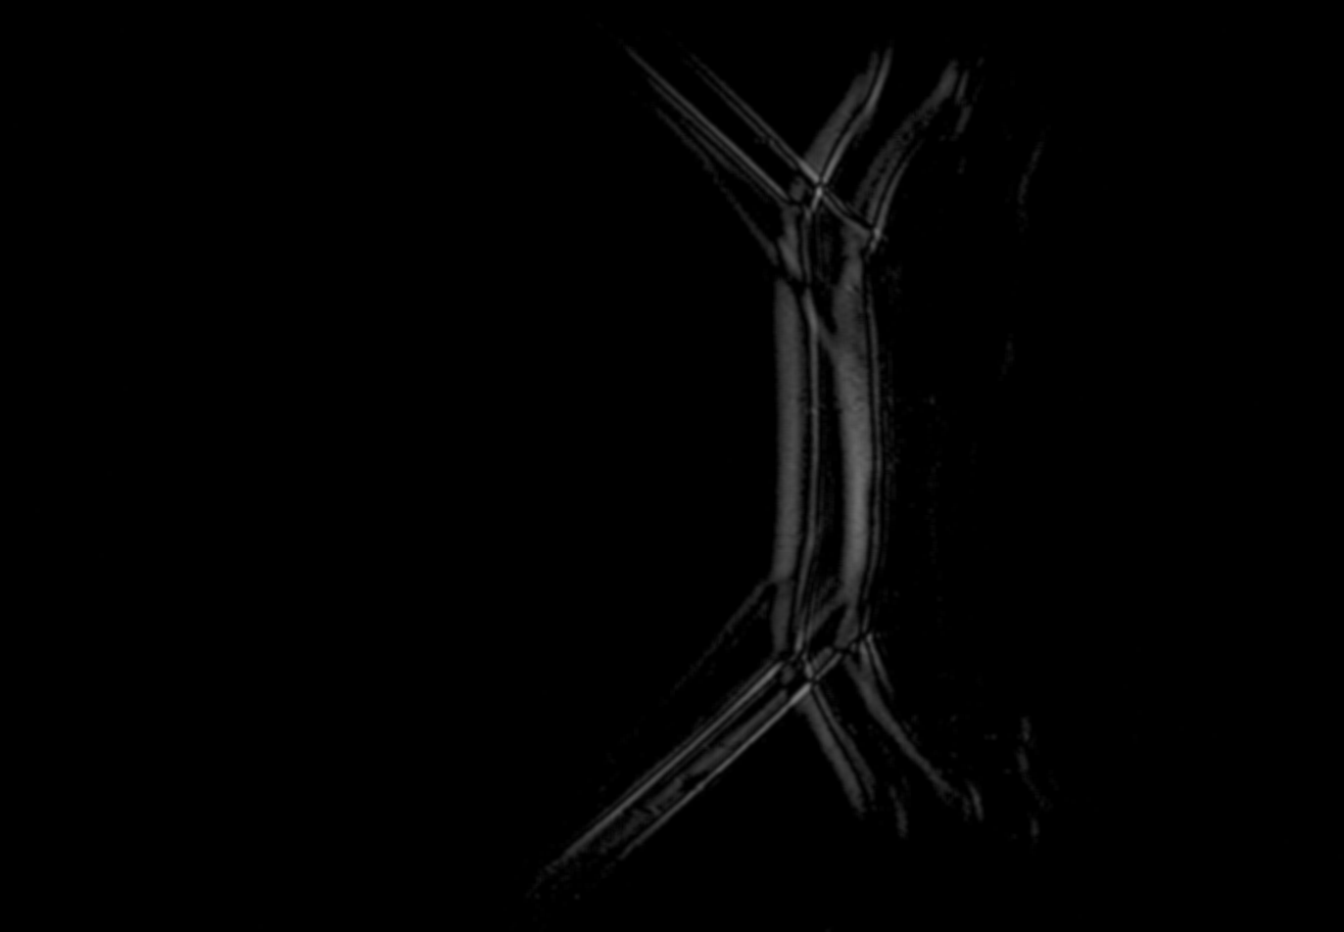
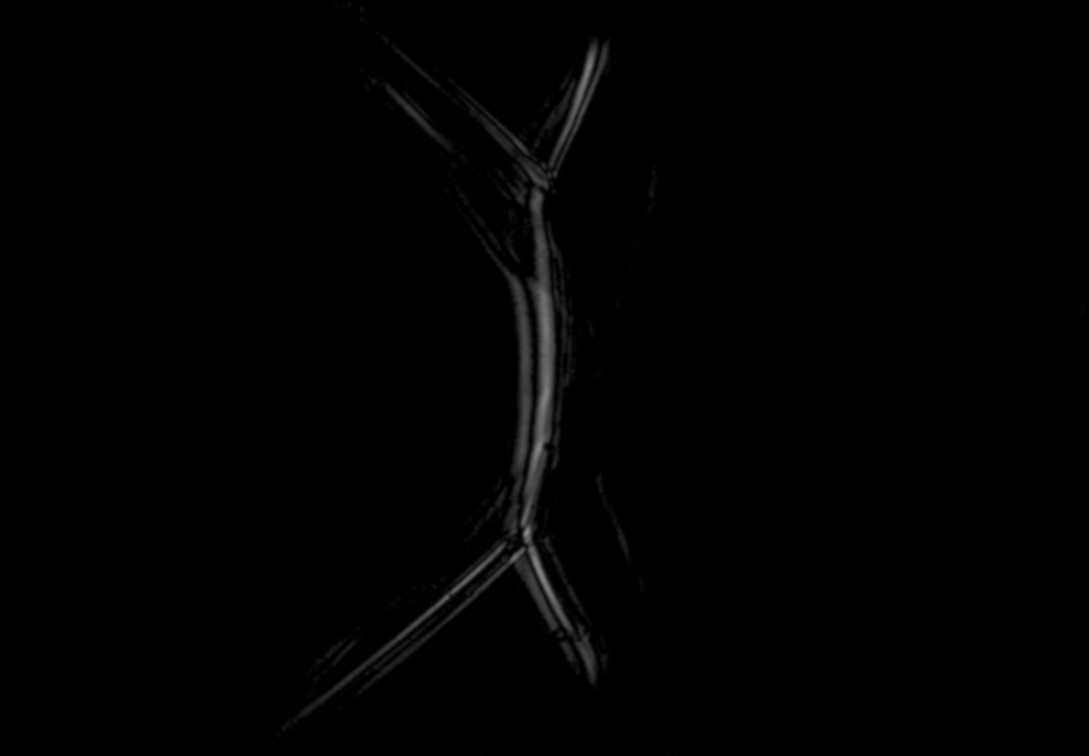
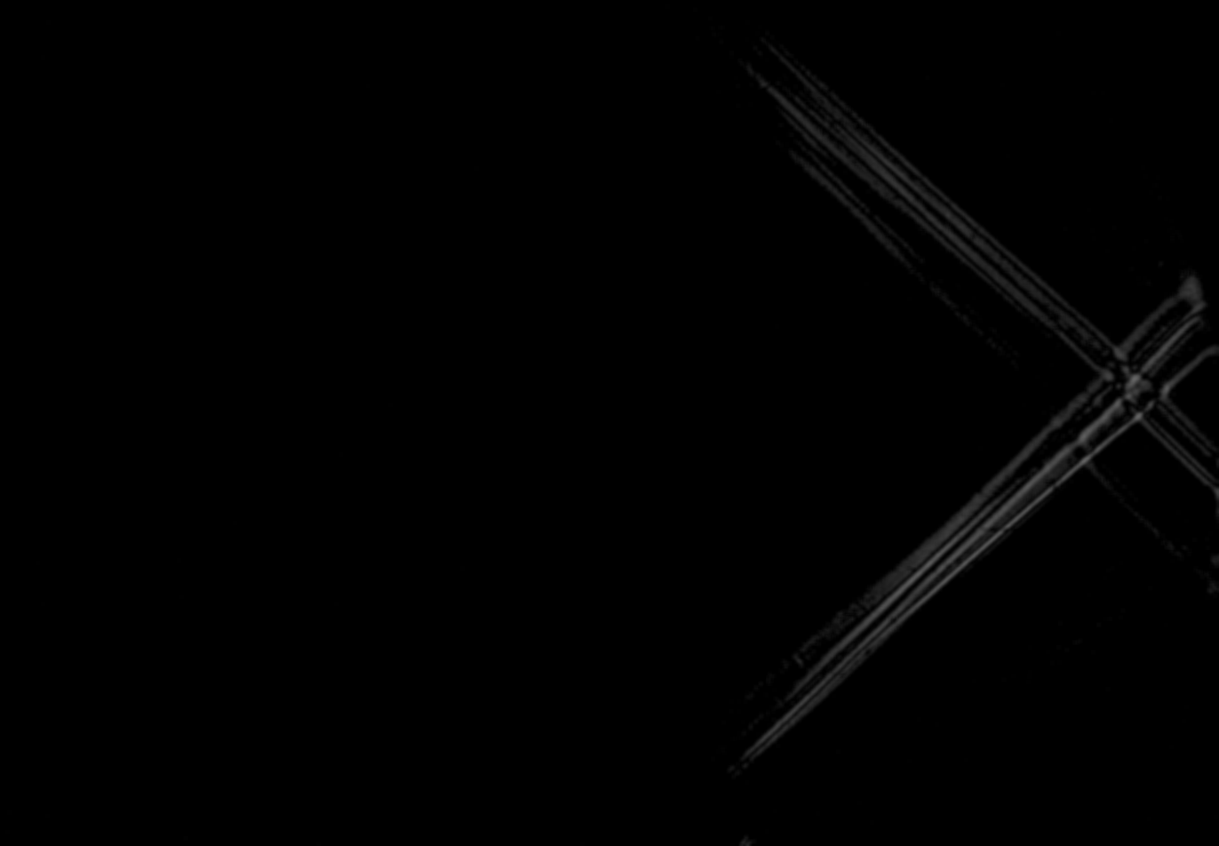
Try to visualize Supersonic Flow

Slide 14
POD
The proper orthogonal decomposition (POD) is one of the most used data analysis and modeling techniques in fluid mechanics and has seen many formulations, variants, and applications over the years.
Suppose we have data that is a function of both space and time.Now,
How can I use this data to decompose this system into its building blocks?
How can we start to understand the features present in the data?
How can we efficiently store/represent/manipulate the data?
Can we build a reduced-complexity model for the dynamics that we are interested in?
Notes:
Pod algorithm is defined such that it maximize the energy along each one of its basis vector sequentially such that each subsequent basis vector is perpendicular to all the previous basis vector .
This method facilitates the analysis of large datasets by reducing the order description process. This leads to easier identification of processes that occur in the system under study.

Slide 15
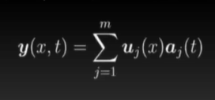
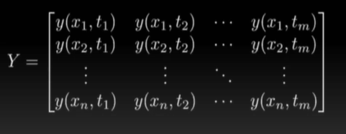
To start to answer these questions, we can start with a simple separation of variables:
Suppose we collect data at spatial locations X1, X2 ,X3..,Xn
Suppose we collect data at times ti,t2t3,.....,tm
We can start by assembling the data y(x,t) into an m x n matrix
Notes:
To start to answer these questions, we can start with a simple separation of variables:

Slide 16
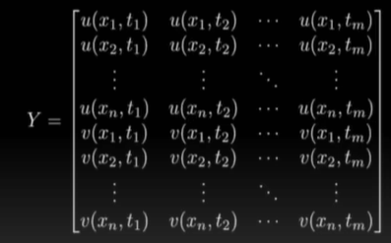
If we are measuring vector quantities, we can stack these into the data matrix Similarity.For example, if we measure two components of velocity, u and v.
Reference: https://youtu.be/TcqBbtWTcIc

Slide 17
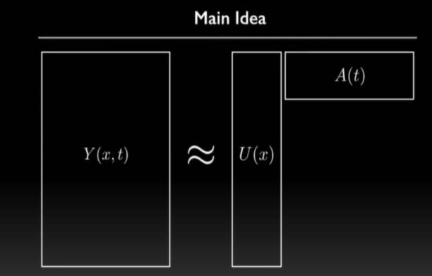
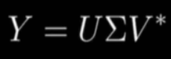
This can be achieved using through a singular value decomposition:
Notes:
Y whose columns represents the snapshot of the data flattened into the single column,each snapshot of is a snapshot in time
The first unitary matrix,means its inverse equals it conjugate transpose. u is a matrix of basis vector and modes each column of this matrix is a mode that represents a spatial pattern that is dominant in the data and they are organised in decreasing order of energy.
The Sigma is a diagonal matrix and each of its diagonal matrix represent square root of the energy of the data along the corresponding singular vector
V is also unitary matrix and we uses its transpose,each one of its column is also singular vector

Slide 18
POD using Full Singular Value Decomposition
Notes:
Aman

Slide 19
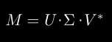
Singular Value Decomposition
It is an important tool used for data processing. It has to do with data reduction, to find the key correlations. It uses linear algebra to find the most influencing characteristic for any set of data given.
In this we decompose a matrix A into three different matrices each carrying their own significance and for the understanding of the modes.

Slide 20
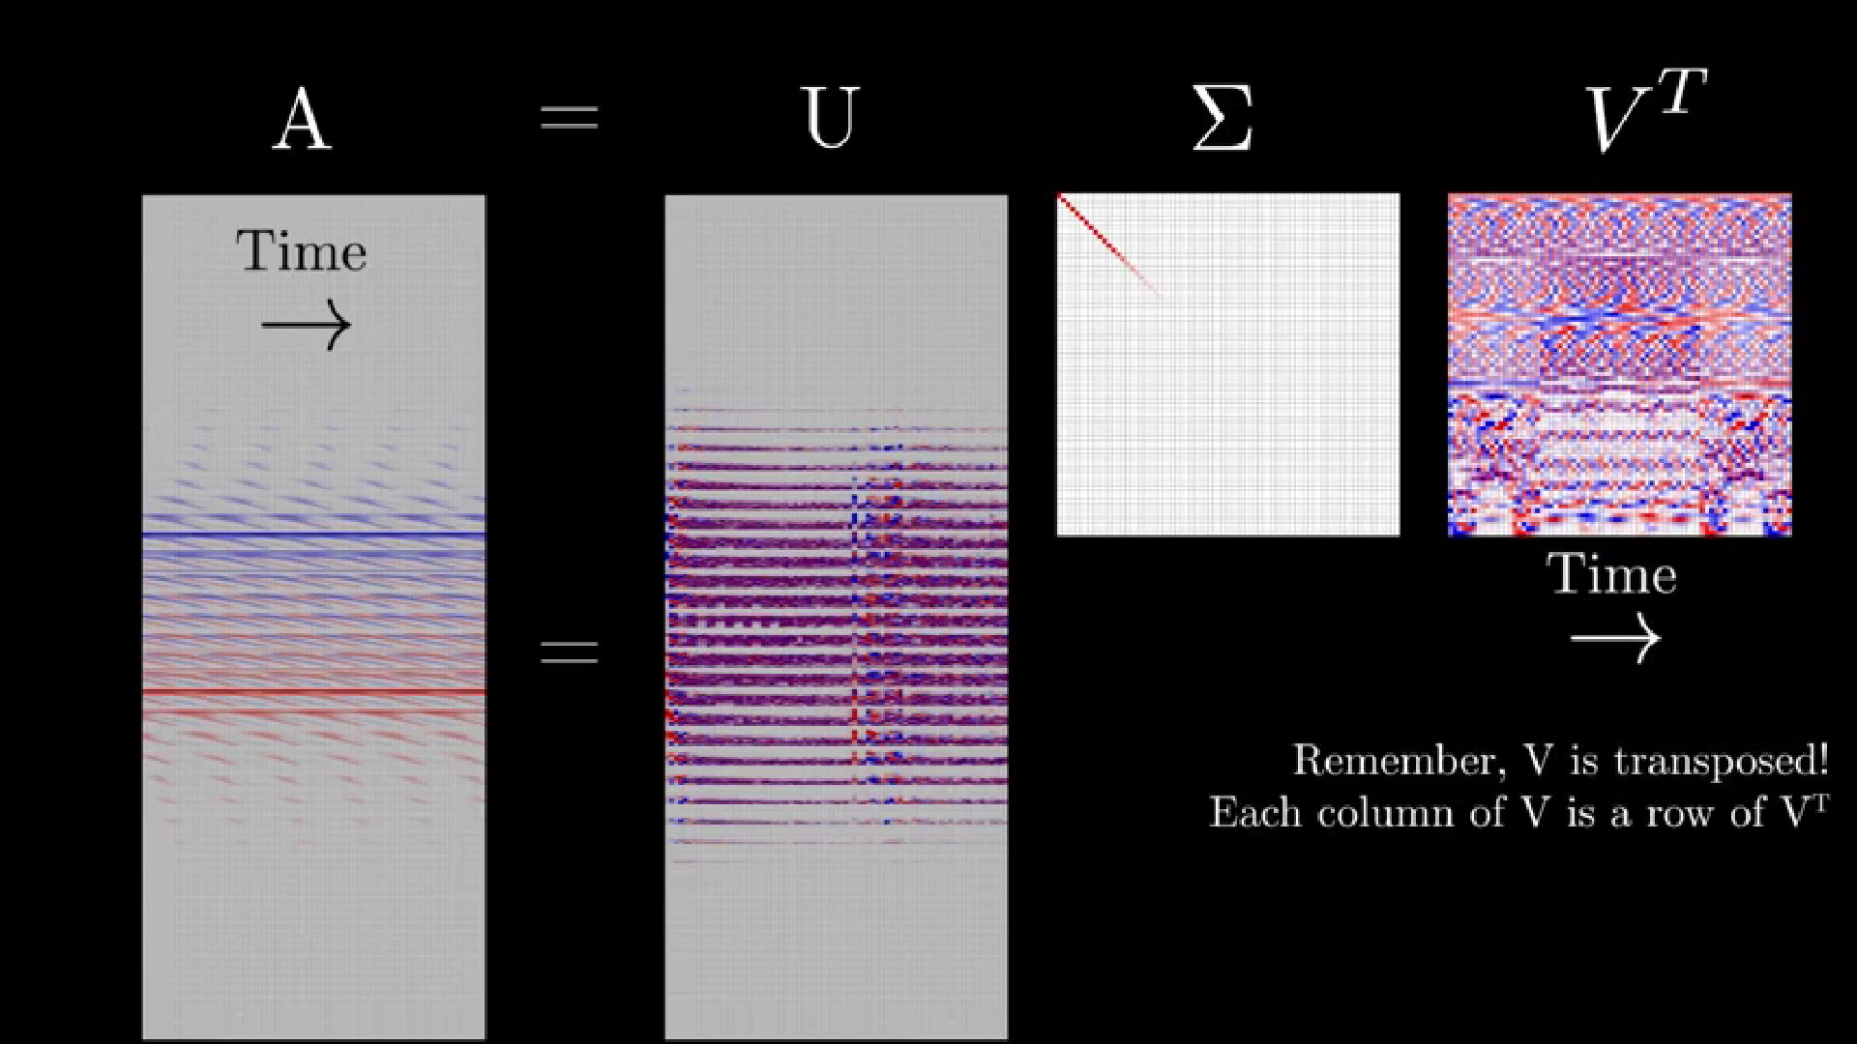
Ref: https://youtu.be/axfUYYNd-4Y

Slide 21
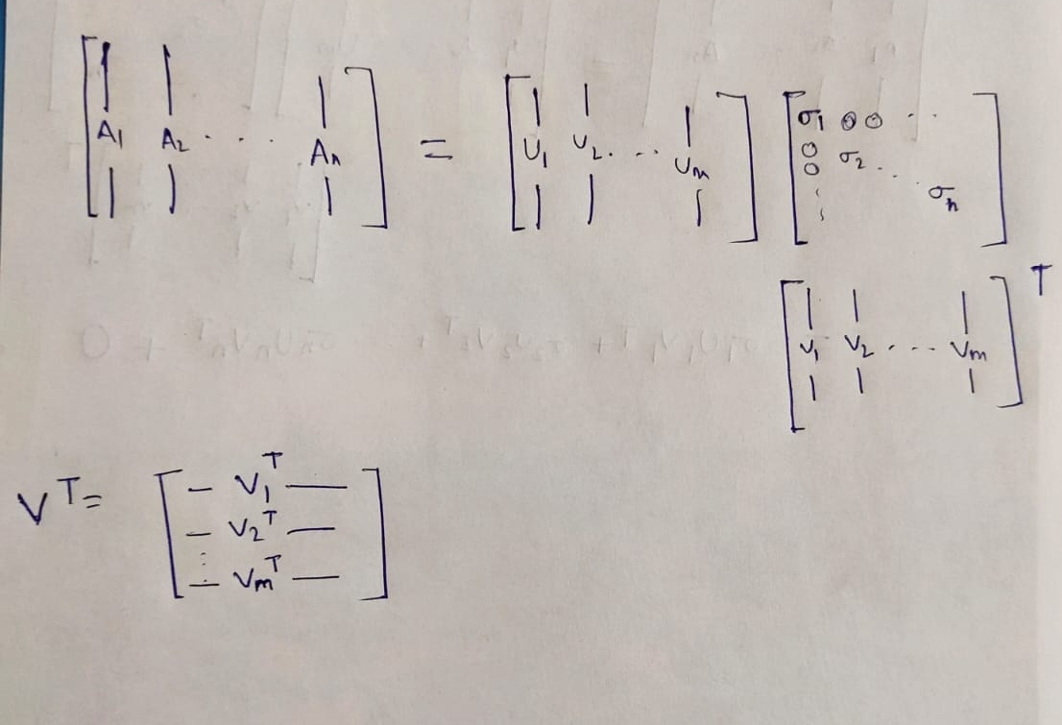
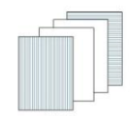
Understanding and Visualizing

Slide 22
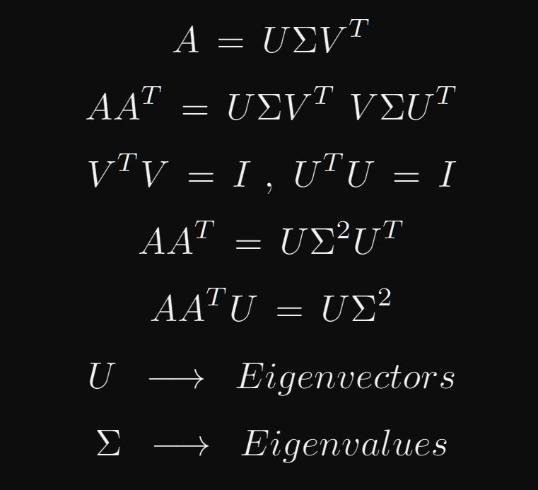
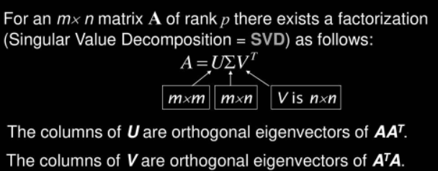
Interpretation

Slide 23
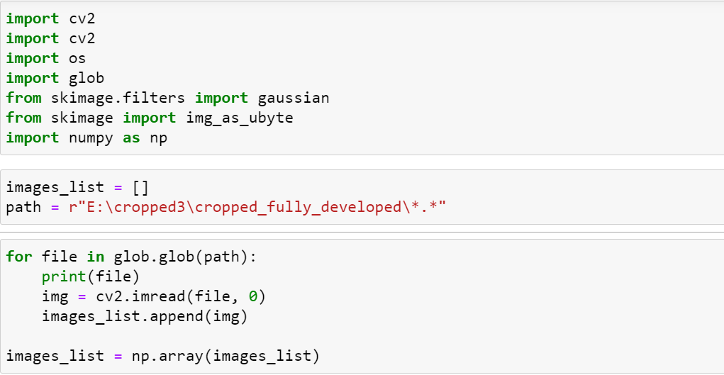
Code For SVD

Slide 24
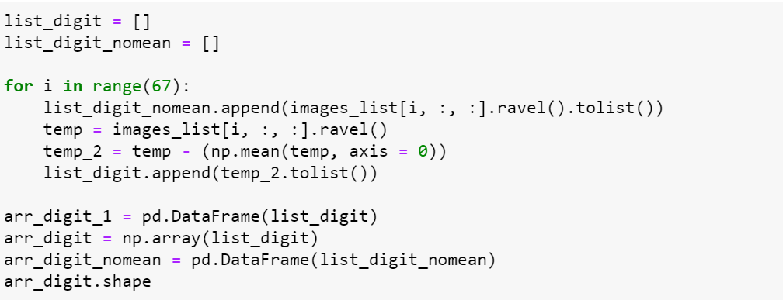
Preprocessing

Slide 25
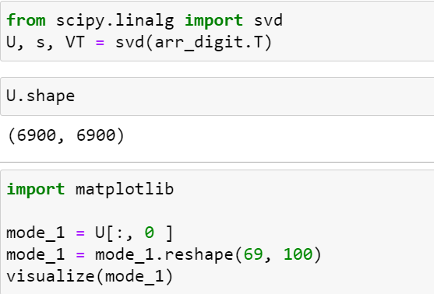

Slide 26
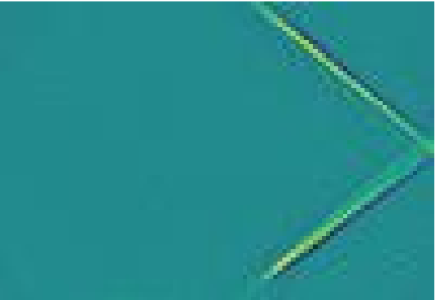
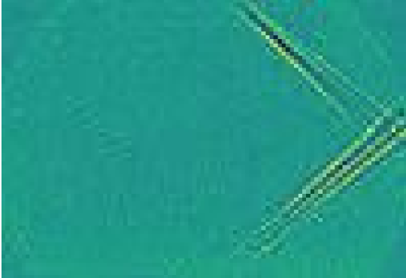
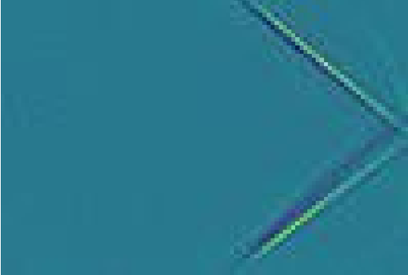
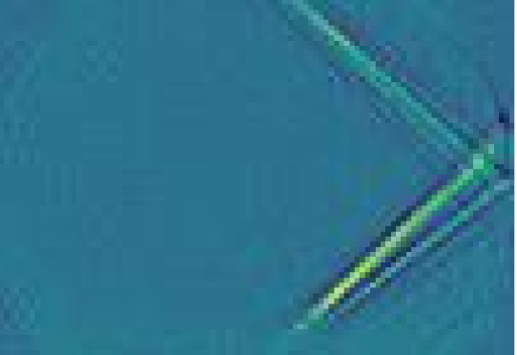
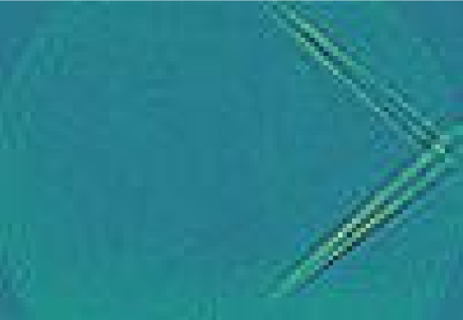
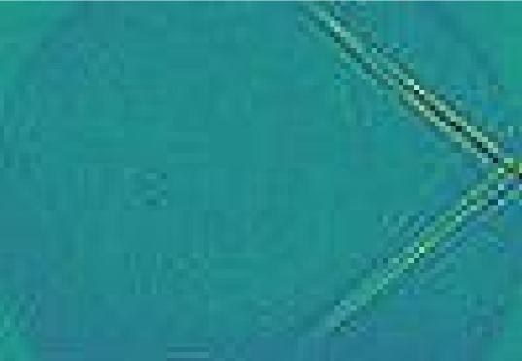

Slide 27
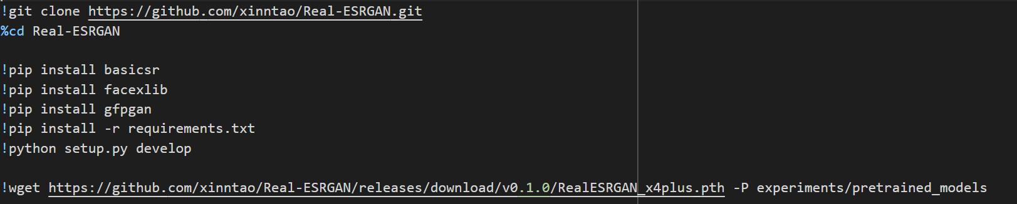
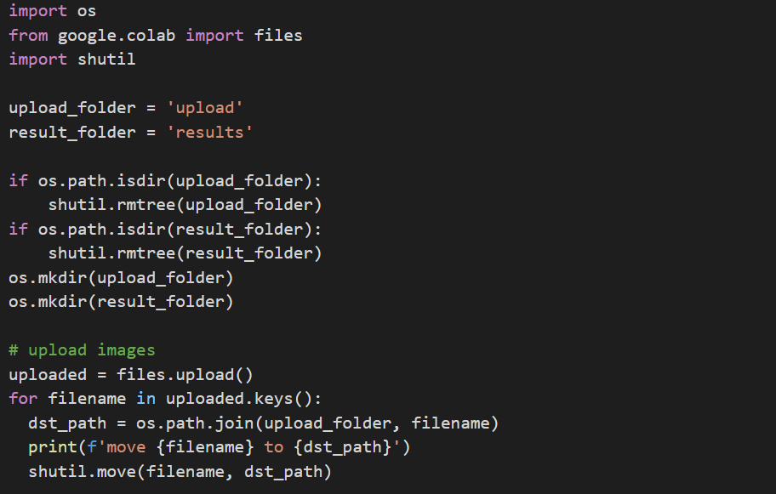

Slide 28
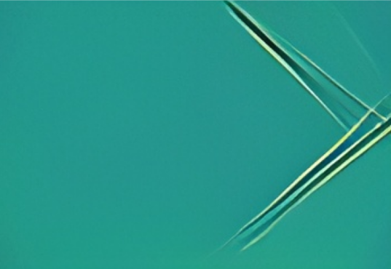

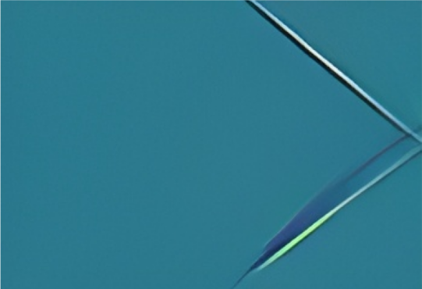
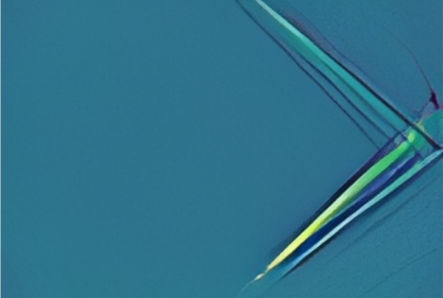

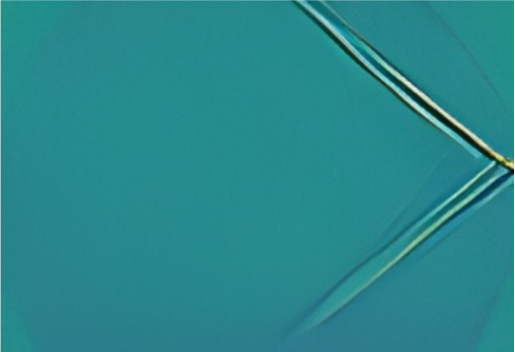
Notes:
Aman

Slide 29
POD on Laser Smoke Screen Flow Visualisation

Slide 30
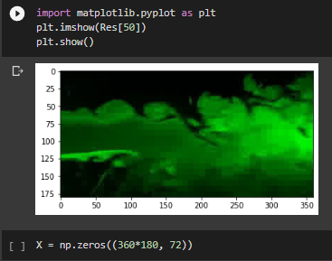

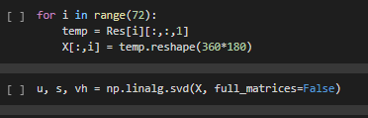
POD using SVD(reduced)
(Laser Smoke Screen method)
Notes:
Colour suppress:

Slide 31

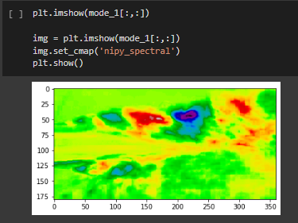
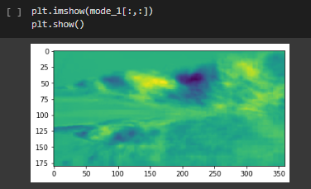

Slide 32
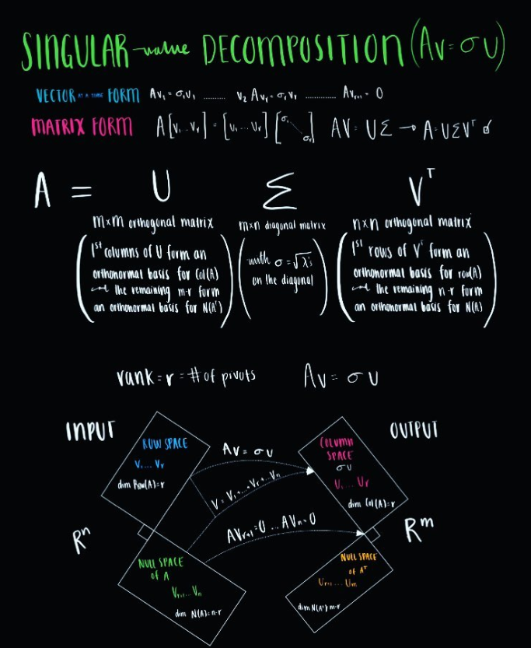
Method Used here is Singular Value Decomposition (SVD)
Reference:
Datadiagrams

Slide 33

Graphical Representation
Reference:
Datadiagrams

Slide 34
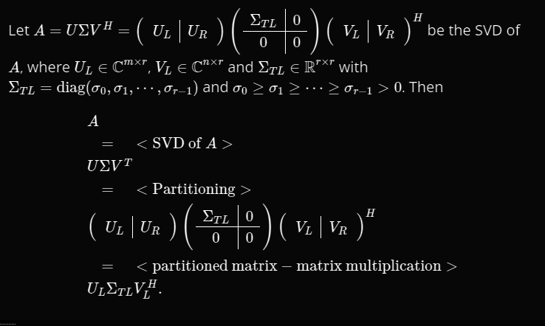
Reduced SVD
the m−r columns that span the left null space are removed from U.
the padded rows and columns of zeros are removed from Σ.
the n−r columns that span the null space are removed from V.
Both reduced SVD and full SVD results in the original A with no information loss.
Source: https://www.cs.utexas.edu/users/flame/laff/alaff/chapter02-the-reduced-svd.html

Slide 35
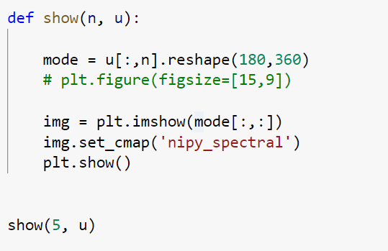

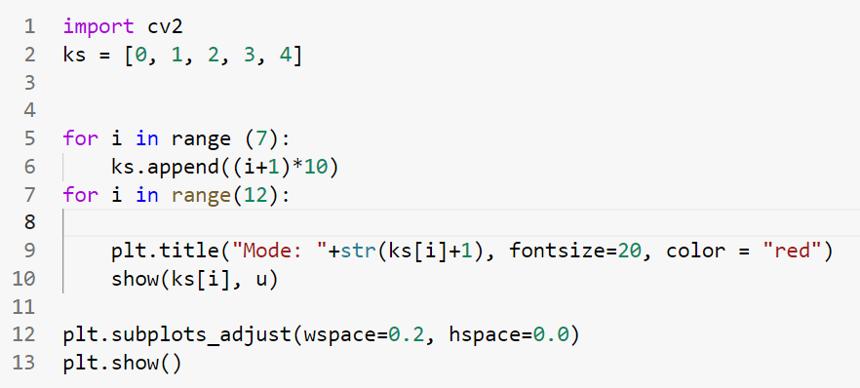
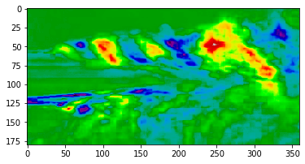

Slide 36










Slide 37
POD using Covariance Matrix

Slide 38
Proper Orthogonal Decomposition
(Covariance Matrix Method)
The method of covariance calculation for the use in proper orthogonal decomposition is mainly used as a statistical method contrary to the SVD method which is mainly used as a tool of linear algebra.
In this method, the first goal is to convert the given images into a linear array. The input images for this case (shock wave images) are of the size 1920 x 1080 pixels. These are first resolved into a smaller dimension of 100 x 69 pixels. This is done so as to reduce the calculative complexity (memory and time) that is faced during the covariance matrix generation and calculation.
The entire input image can be considered to be an array of the dimension 100 x 69. This can be converter into a linear array of the size 1 x 6900 elements. This process is repeated for all the images (124 images of final generated shock) to create a final 2D array of dimensions 124 x 6900. This array represents the entire set of useful images.
Notes:
Rushil - Start

Slide 39




Slide 40

Importing of Useful Images

Slide 41

Linearisation, Stacking and Mean Subtraction of Image Pixels

Slide 42

Next, the covariance matrix is calculated. The covariance matrix calculation can be done by:
The covariance matrix in our case has a dimension of 6900 x 6900. Next, we find the eigen vectors and eigen values of the covariance matrix. The eigen vectors arranged in the descending order of the eigen values gives the modes arranged in the most dominating to least dominating order.

Slide 43

Covariance matrix, Eigenvector and Eigen Value Calculation

Slide 44


Visualising and Saving of first 50 Modes

Slide 45






Mode 1
Mode 2
Mode 3
Mode 4
Mode 5
Mode 6

Slide 46
Issues Encountered During Finding the POD from Covariance Matrix
A few issues encountered during the processing of the images were:
Using the original 1920 x 1080 pixel images causes memory overflow in the programming hardware due to the formation of 20,73,600 x 20,73,600 matrix which required an unachievable processing memory of 15 Tb.
The next issue encountered was that initially, all of the images were considered for the POD formation. Though this method is completely suitable for PCA, this method is not suitable for POD because of the time dependence of all images. Considering all images resulted in modes which were overlap of modes of all different images including the startup, transition and final shock.
The last issue encountered was about the resolution of the final image. These images to a certain extent were incomprehensible because of their lower resolution. This was solved by using the aforementioned resolution enhancing algorithm.

Slide 47
This particular covariance matrix can further be used to do principal component analysis. In this, any top ‘k’ eigen vectors in the sorted fashion are taken, transposed and multiplied with the original image to facilitate dimensionality reduction.
The images thus generated will only contain the information related to the top ‘k’ modes of the images. Here ‘k’ can be any number of dimensions less than or equal to the the initial feature dimensions.
Further, the first mode obtained has been used to generate a saliency mapped image. In this, the aim is to separate the shock wave structure in the image from the background which is not actually necessary to extract any useful information.
For this, an unsupervised learning algorithm known as the k-means clustering is used. In this, regions of similar colour gradients are clubbed together. Next, the image is thresholded to generate a black and white image. By the use of some angle finding algorithms, the angle enclosed between the shock waves is found. This can be used to generate the mach number of the flow computationally.

Slide 48

Principle Component Analysis

Slide 49


Slide 50

Image with PCA with k = 10

Slide 51


Generating Clustered Image

Slide 52





-Results-
Source : Edge Detection Using OpenCV | LearnOpenCV #
Notes:
Rushil - End

Slide 53


Notes:
This is done using Hough line Transformation which is used to detect any shape. It stores r and theta in a 2D array where theta is measured in the counterclockwise direction. Using this theta we calculate the Mach Number using the calculator provided.

Slide 55
Miscellaneous

Slide 56


Experiment to mimic multiple jet interference
Square Cross Section
Circular Cross Section
These plates were made to mimic flow of multiple jets placed close to each other but due to material constraint we did not used these plates to perform experiment. The material used (Aluminium) was deemed unsafe for use at high velocity flows.

Slide 57


Our goal to achieve from the plates manufactured

Slide 58
Acknowledgements
Thank you.
Supervisor : Prof. Arun Kumar R
And, to postgraduate students who coordinated the supersonic lab for the Schlieren experiments.

